Slide 1
Chapter 2
The Business, Tax, and Financial Environments

Slide 2
The Business, Tax, and Financial Environments
The Business Environment
The Tax Environment
The Financial Environment

Slide 3
The Business Environment
There are four basic forms of business organization:
Sole Proprietorships
Partnerships (general and limited)
Corporations
Limited liability companies

Slide 4
The Business Environment
Sole Proprietorship -- A business form for which there is one owner. This single owner has unlimited liability for all debts of the firm.
Oldest form of business organization.
Business income is accounted for on the owner’s personal income tax form.

Slide 5
Summary for
Sole Proprietorship
Advantages
Simplicity
Low setup cost
Quick setup
Single tax filing on individual form
Disadvantages
  Unlimited liability
  Hard to raise additional capital
  Transfer of ownership difficulties

Slide 6
The Business Environment
Partnership -- A business form in which two or more individuals act as owners.
Business income is accounted for on each partner’s personal income tax form.

Slide 7
Types of Partnerships
General Partnership -- All partners have unlimited liability and are liable for all obligations of the partnership.
Limited Partnership -- Limited partners have liability limited to their capital contribution (investors only). At least one general partner is required and all general partners have unlimited liability.

Slide 8
Summary for Partnership
Advantages
Can be simple
Low setup cost, higher than sole proprietorship
Relatively quick setup
Limited liability for limited partners
Disadvantages
Unlimited liability for the general partner
Difficult to raise additional capital, but easier than sole proprietorship
Transfer of ownership difficulties

Slide 9
The Business Environment
Corporation -- A business form legally separate from its owners.
An artificial entity that can own assets and incur liabilities.
Business income is accounted for on the income tax form of the corporation.

Slide 10
Summary for Corporation
Advantages
Limited liability
Easy transfer of ownership
Unlimited life
Easier to raise large quantities of capital
Disadvantages
Double taxation
More difficult to establish
More expensive to set up and maintain

Slide 11
The Business Environment
Limited Liability Companies -- A business form that provides its owners (called “members”) with corporate-style limited personal liability and the federal-tax treatment of a partnership.
Business income is accounted for on each “member’s” individual income tax form.

Slide 12
Limited Liability Company (LLC)
Generally, an LLC will possess only the first two of the following four standard corporation characteristics
Limited liability
Centralized management
Unlimited life
Transfer of ownership without other owners’ prior consent

Slide 13
Summary for LLC
Advantages
Limited liability
Eliminates double taxation
No restriction on number or type of owners
Easier to raise additional capital
Disadvantages
Limited life (generally)
Transfer of ownership difficulties (generally)

Slide 14
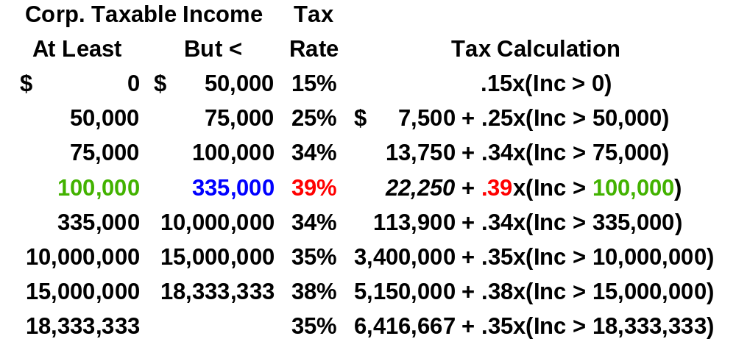
Corporate Income Taxes

Slide 15
Income Tax Example
Lisa Miller of Basket Wonders (BW) is calculating the income tax liability, marginal tax rate, and average tax rate for the fiscal year ending December 31.
BW’s corporate taxable income for this fiscal year was $250,000.

Slide 16
Income Tax Example
Income tax liability = $22,250 + .39 x ($250,000 - $100,000) = $22,250 + $58,500 = $80,750
Marginal tax rate = 39%
Average tax rate = $80,750 / $250,000 = 32.3%

Slide 17
Depreciation
Depreciation represents the systematic allocation of the cost of a capital asset over a period of time for financial reporting purposes, tax purposes, or both.
Generally, profitable firms prefer to use an accelerated method for tax reporting purposes.

Slide 18
Common Types of Depreciation
Straight-line (SL)
Accelerated Types
    Double-Declining-Balance (DDB)
    Modified Accelerated Cost Recovery System (MACRS)

Slide 19
Depreciation Example
Lisa Miller of Basket Wonders (BW) is calculating the depreciation on a machine with a depreciable basis of $100,000, a 6-year useful life, and a 5-year property class life.
She calculates the annual depreciation charges using MACRS.

Slide 20
MACRS Example
Assets are depreciated based on one of eight different property classes.
Generally, the half-year convention is used.
Depreciation in any particular year is the maximum of DDB or straight-line. A switch in depreciation methods is made from DDB to SL during the life of the asset.

Slide 21
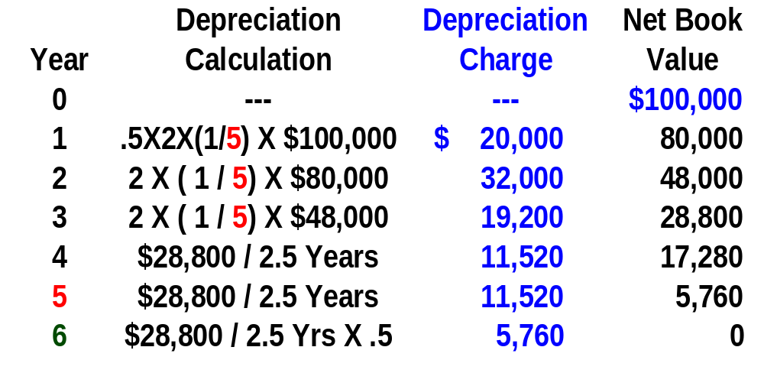
MACRS Example

Slide 22
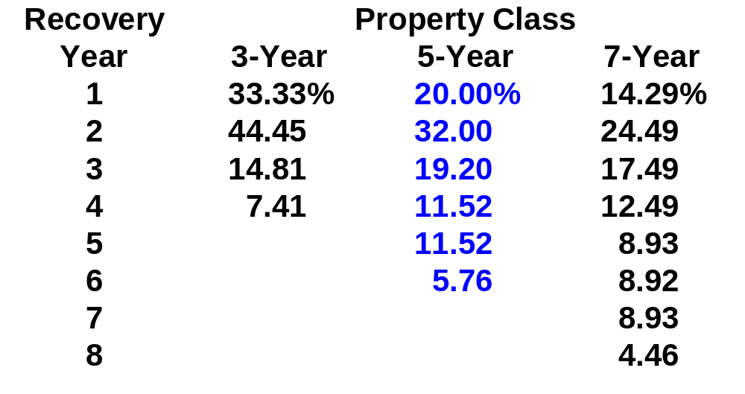
MACRS Schedule

Slide 23
Interest Deductibility
Interest Expense is the interest paid on outstanding debt and is tax deductible.
Cash Dividend is the cash distribution of earnings to shareholders and is not a tax deductible expense.
The after-tax cost of debt is: (Interest Expense) X ( 1 - Tax Rate)
Thus, debt financing has a tax advantage!

Slide 24
Handling Corporate Losses and Gains
Corporations that sustain a net operating loss can carry that loss back (Carryback) 2 years and forward (Carryforward) 20 years to offset operating gains in those years.
Losses are generally carried back first and then forward starting with the earliest year with operating gains.

Slide 25
Corporate Losses and Gains Example
Lisa Miller is examining the impact of an operating loss at Basket Wonders (BW) in 2003. The following time line shows operating income and losses. What impact does the 2003 loss have on BW?
2000
2001
2002
2003
$150,000
$150,000
$100,000
-$500,000

Slide 26
Corporate Losses and Gains Example
The loss can offset the gain in each of the years 2001 and 2002. The remaining $250,000 can be carried forward to 2004 or beyond.
2000
2001
2002
2003
$150,000
$150,000
$100,000
-$500,000
-$150,000
-$100,000
$250,000
$150,000
0
0
-$250,000

Slide 27
Corporate Capital Gains / Losses
Generally, the sale of a “capital asset” (as defined by the IRS) generates a capital gain (asset sells for more than original cost) or capital loss (asset sells for less than original cost).
Often historically, capital gains income has received more favorable U.S. tax treatment than operating income.

Slide 28
Corporate Capital Gains / Losses
Currently, capital gains are taxed at ordinary income tax rates for corporations, or a maximum 35%.
Capital losses are deductible only against capital gains.

Slide 29
Personal Income Taxes
The U.S. has a progressive tax structure with four tax brackets of 15%, 28%, 31%, and 36%.
A 10% surtax is applied to certain high income individuals raising their marginal rate to 39.6%.
Personal income taxes are determined by taxable income, filing status, and various credits.

Slide 30
Financial Environment
Businesses interact continually with the financial markets.
Financial Markets are composed of all institutions and procedures for bringing buyers and sellers of financial instruments together.
The purpose of financial markets is to efficiently allocate savings to ultimate users.

Slide 31
Flow of Funds in the Economy
INVESTMENT SECTOR
FINANCIAL BROKERS
FINANCIAL
INTERMEDIARIES
SECONDARY MARKET
SAVINGS SECTOR

Slide 32
Flow of Funds in the Economy
INVESTMENT SECTOR
INVESTMENT
SECTOR
Businesses
Government
Households
FINANCIAL BROKERS
FINANCIAL
INTERMEDIARIES
SECONDARY MARKET
SAVINGS SECTOR

Slide 33
Flow of Funds in the Economy
INVESTMENT SECTOR
SAVINGS
SECTOR
Households
Businesses
Government
FINANCIAL BROKERS
FINANCIAL
INTERMEDIARIES
SECONDARY MARKET
SAVINGS SECTOR

Slide 34
Flow of Funds in the Economy
INVESTMENT SECTOR
FINANCIAL
BROKERS
Investment Bankers
Mortgage Bankers
FINANCIAL BROKERS
FINANCIAL
INTERMEDIARIES
SECONDARY MARKET
SAVINGS SECTOR

Slide 35
Flow of Funds in the Economy
INVESTMENT SECTOR
FINANCIAL
INTERMEDIARIES
Commercial Banks
Savings Institutions
Insurance Cos.
Pension Funds
Finance Companies
Mutual Funds
FINANCIAL BROKERS
FINANCIAL
INTERMEDIARIES
SECONDARY MARKET
SAVINGS SECTOR

Slide 36
Flow of Funds in the Economy
INVESTMENT SECTOR
SECONDARY
MARKET
Security
Exchanges
OTC
Market
FINANCIAL BROKERS
FINANCIAL
INTERMEDIARIES
SECONDARY MARKET
SAVINGS SECTOR

Slide 37
Allocation of Funds
Funds will flow to economic units that are willing to provide the greatest expected return (holding risk constant).
In a rational world, the highest expected returns will be offered only by those economic units with the most promising investment opportunities.
Result: Savings tend to be allocated to the most efficient uses.

Slide 38
Risk-Expected Return Profile
Speculative Common Stocks
Conservative Common Stocks
Preferred Stocks
Medium-grade Corporate Bonds
Investment-grade Corporate Bonds
EXPECTED RETURN (%)
Long-term Government Bonds
Prime-grade Commercial Paper
U.S. Treasury Bills (risk-free securities)
RISK

Slide 39
What Influences Security Expected Returns?
Default Risk is the failure to meet the terms of a contract.
Marketability is the ability to sell a significant volume of securities in a short period of time in the secondary market without significant price concession.

Slide 40
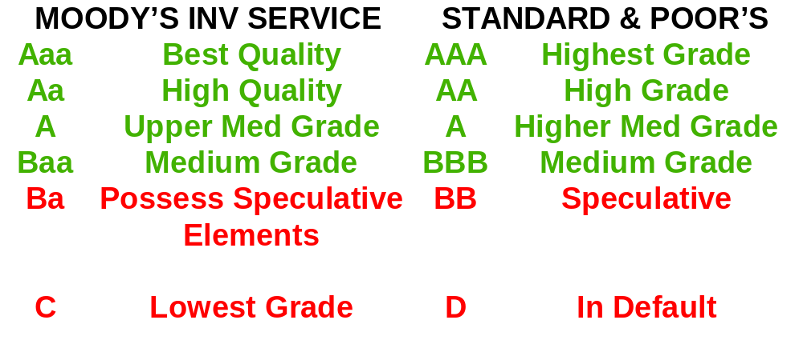
Ratings by Investment Agencies on Default Risk
Investment grade represents the top four categories.
Below investment grade represents all other categories.

Slide 41
What Influences Expected Security Returns?
Maturity is concerned with the life of the security; the amount of time before the principal amount of a security becomes due.
Taxability considers the expected tax consequences of the security.

Slide 42
Term Structure of Interest Rates
Upward Sloping Yield Curve
(Usual)
YIELD (%)
0 2 4 6 8 10
Downward Sloping Yield Curve
(Unusual)
0 5 10 15 20 25 30
YEARS TO MATURITY
A yield curve is a graph of the relationship between yields and term to maturity for particular securities.

Slide 43
What Influences Expected Security Returns?
Embedded Options provide the opportunity to change specific attributes of the security.
Inflation is a rise in the average level of prices of goods and services. The greater inflation expectations, then the greater the expected return.

